Slide 1
Yearly Achievement Report 2026
Presenter’s Name : Brian Gabriel Alban
Presenter’s Dept.: EDT220
2026/10/03

Slide 2
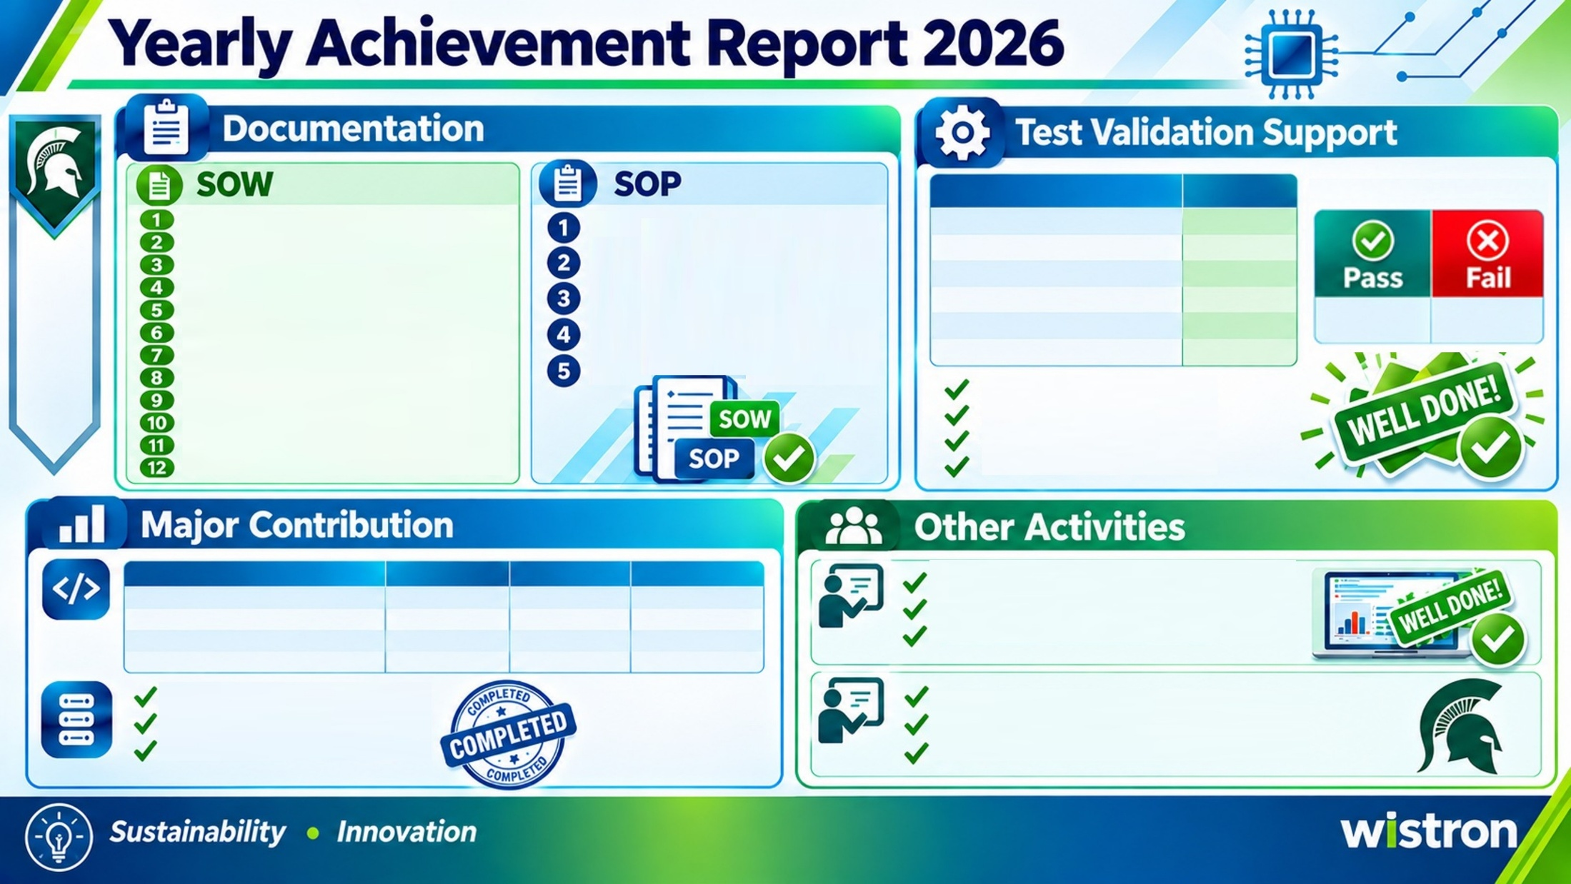








SKU Name
Remarks
EC_814 PCIE Test Monitoring
Brother Printer Label Printing SOW
Fusion eye Batch Stop & Start Test Standard Procedure
Fusion eye Rack Auto-Lock Assignment SOP
GB300_PG548 Rack set-up Standard Procedure
GB300_PG548 Validation Flow Standard Procedure
GB300PG548 Tray Manual Setup Standard Procedure
PG548_26Q3_MP_Bianca_53517
Completed
Fusion eye Batch Stop & Start Test SOW
PG548_26Q3_MP_Bianca_GB300_53457
Completed
Fusion eye Rack Auto-Lock Assignment SOW
PG548_26Q3_MP_Bianca_GB300_53412
Completed
N2 UT3.2 Quark Tray Validation SOW
PG548_26Q2_MP_Bianca_GB300_53454
Completed
548
8
N2 Serial Number Manual Checkout SOW
PG548 INIT Failed Unable to connect port SOW
PG548_26Q1_MP_Bianca_51526
Completed
PG548 N2 EC_766 Check DUT IP SOW
PG548_26Q1_MP_Bianca_51652
Completed
PG548 N2 EC_633 cpld-version-not-match SOW
Setup
Testing
FW Checking
Release to Production
PG548 N2 EXITCODE[255] Troubleshooting SOW
PG548 N2 EXITCODE[127] Troubleshooting SOW
PG548 N2 WIST_6 DUT FRU SN is mismatch SOW
PG548 N2 INIT_PKG_FAIL_05 SOW
Script Optimization
New TE DL Training Evaluation Report (2 new DL)
Script Name
Original Time
Optimize Time
Time Save (%)
Tracked progress, recorded scores, and managed weekly
Delivered assessments, practical exams, and feedback
Evaluated and passed 2 participants
RN_Repair.sh
water_flow_check.sh
get_sfcs_GETNVFRU2.sh
Auto_Flash_PCIe_FW_local_vm.sh
180 Sec.
120 Sec.
180 Sec.
180 Sec.
15 Sec.
10 Sec.
10 Sec.
10Sec.
91.67%
91.67%
91.67%
94.44%
POD 4 New Build PG548 Rack Automation - 54 Racks
New Spartan Training Candidates (3 Participants)
Network Checking
Cabling and Harnessing
Automation Test Assisting
Prepare Two Training Topics Related to the TE-Spartan/TE-DL Work Process
Schedule and Conduct Hands-On Training for the Candidates
Conduct Written and Practical Examinations, Then Evaluate the Performance

Slide 3
Thank You!

